Slide 1

🔌 Electricity Price Prediction with Machine Learning
This project delivers an end-to-end machine learning solution for forecasting electricity prices, a critical capability for energy market participants, grid operators, and large-scale consumers.

Slide 2

📌 Project Overview: Core Capabilities
Comprehensive Data Analysis
Advanced Data Preprocessing
Machine Learning Pipeline
Leveraging Pandas for exploratory data analysis (EDA), statistical analysis, and robust data profiling. Includes advanced handling of missing values and rigorous data quality checks.
Featuring outlier detection and removal using the Interquartile Range (IQR) method, feature scaling with StandardScaler, and sophisticated time-series feature engineering. Ensures temporal ordering preservation during train-test splits.
Implementation of a Linear Regression model with hyperparameter tuning, cross-validation, and in-depth feature importance analysis. Models are persisted for seamless production deployment.
Rigorous Performance Evaluation
Interactive Visualizations
Utilizing multiple evaluation metrics such as RMSE, MAE, and R², alongside detailed residual analysis and model interpretability. Performance is benchmarked against baseline models.
Providing dynamic time-series plots comparing actual versus predicted values, correlation heatmaps, feature distribution analyses, and comprehensive model performance dashboards for actionable insights.

Slide 3

🛠️ Technical Stack & Dependencies
Core Technologies
Python 3.8+: Primary programming language
Jupyter Notebook: Interactive development environment
scikit-learn: Machine learning algorithms and utilities
pandas: Data manipulation and analysis
NumPy: Numerical computing
Matplotlib/Seaborn: Data visualization
joblib: Model persistence
Installation Steps
Clone the repository: git clone [repository_url]
Create and activate a virtual environment.
Install dependencies: pip install -r requirements.txt

Slide 4
🚀 Quick Start Guide
2. Model Training
1. Data Preparation
Train the Linear Regression model using src.model.train_model with the prepared training data.
Load and preprocess data from specified CSV files using src.data_processing.load_and_preprocess_data. This prepares training and testing sets.
4. Making Predictions
3. Model Evaluation
Generate predictions on new data using the trained model's .predict() method.
Evaluate model performance using src.model.evaluate_model which calculates key metrics like RMSE and R² on the test set.

Slide 5
📊 Data Description & Features
The dataset comprises time-series data designed for electricity price forecasting, integrating critical features to capture market dynamics.
T(t-2)
Temperature two time steps before
°C
T(t-1)
Temperature one time step before
°C
T(t)
Current temperature
°C
D(t-2)
Electricity demand two time steps before
MW
D(t-1)
Electricity demand one time step before
MW
D(t)
Current electricity demand
MW
P(t+1)
Electricity price to predict (target variable)
$/MWh
Dataset Statistics: Training samples: 955, Testing samples: 506, Features: 6.

Slide 6
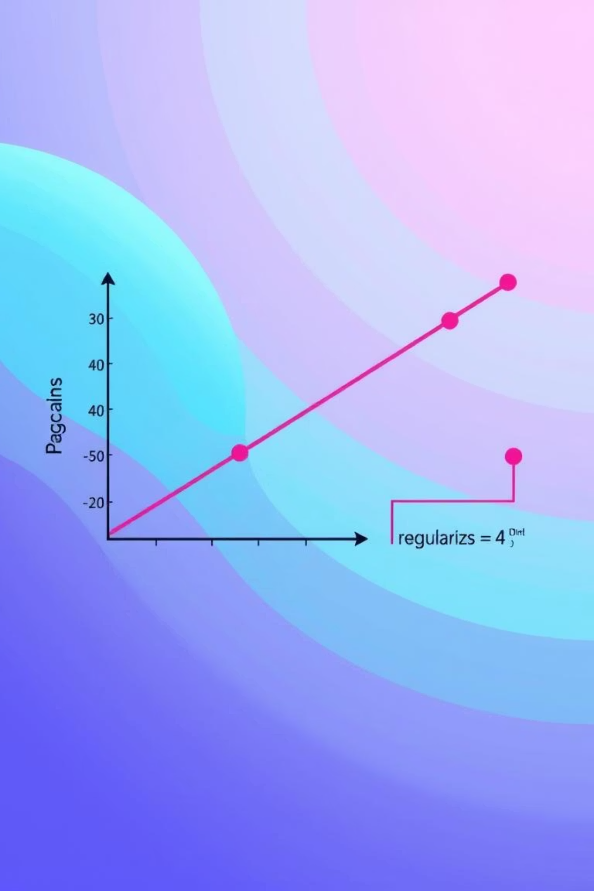
🧠 Model Architecture: Linear Regression with Enhancements
Feature Engineering
Model Selection
Incorporates time-lagged features to capture temporal dependencies, polynomial features for non-linear relationships, and interaction terms between temperature and demand for enhanced predictive power.
Utilizes a Linear Regression algorithm with L2 (Ridge) regularization, cross-validated for optimal alpha. Feature scaling is applied using StandardScaler to ensure zero mean and unit variance.
Hyperparameter Tuning
Employs grid search with 5-fold cross-validation to fine-tune regularization strength (alpha), polynomial degree, and interaction term parameters for peak performance.

Slide 7
📈 Performance Metrics & Key Findings
The model's performance is meticulously evaluated using industry-standard metrics to ensure reliability and accuracy.
RMSE
6.20
20.15
R²
0.3951
0.1242
Key Findings:
The model shows moderate performance on the training set but struggles to generalize to the test set, indicating potential overfitting. Further feature engineering and model exploration are crucial for improvement.

Slide 8
🎯 Applications & Impact
This electricity price prediction model offers diverse applications across the energy sector, driving efficiency and strategic decision-making.
Energy Trading
Grid Operation
Demand Response
Optimizing trading strategies and portfolio management based on accurate price forecasts.
Enhancing scheduling and balancing of power grids for stability and efficiency.
Facilitating effective demand response programs by predicting price fluctuations.
Renewable Integration
Budget Planning
Improving the integration and dispatch of renewable energy sources into the grid.
Enabling large consumers to forecast energy costs and optimize their budget allocations.

Slide 9

🚀 Next Steps & Future Enhancements
To further refine and extend this project, several key areas have been identified for development.
Model Improvement
Explore more complex models like Random Forest or XGBoost.
Implement advanced feature engineering to capture intricate patterns.
Conduct extensive hyperparameter tuning using more sophisticated search techniques.
Feature Engineering Ideas
Develop temporal features such as rolling averages, lagged data, and moving statistics.
Incorporate seasonal indicators: hour of day, day of week, month, and holiday flags.
Create interaction terms between temperature and demand, and polynomial features.
Deployment
Transition the notebook into a deployable application.
Establish an API endpoint for real-time predictions.
Automate the model retraining process to maintain accuracy over time.

Slide 10
⚠️ Project Limitations & Considerations
While robust, this project acknowledges certain limitations that guide future development and application.
Model Complexity
Data Assumptions
Production Considerations
Linear models might not fully capture highly complex, non-linear relationships inherent in electricity price dynamics, and their default feature interactions are limited.
The current approach assumes stationarity in price relationships, and a simple IQR-based outlier removal may not be universally optimal. The model is also limited to the provided feature set.
Current implementation lacks advanced features like model versioning, robust error handling, and a direct API or web interface for real-time deployment.
This project serves as a foundational step, demonstrating a machine learning approach to electricity price prediction using Jupyter Notebook and scikit-learn.

